Slide 1
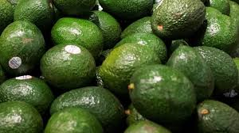
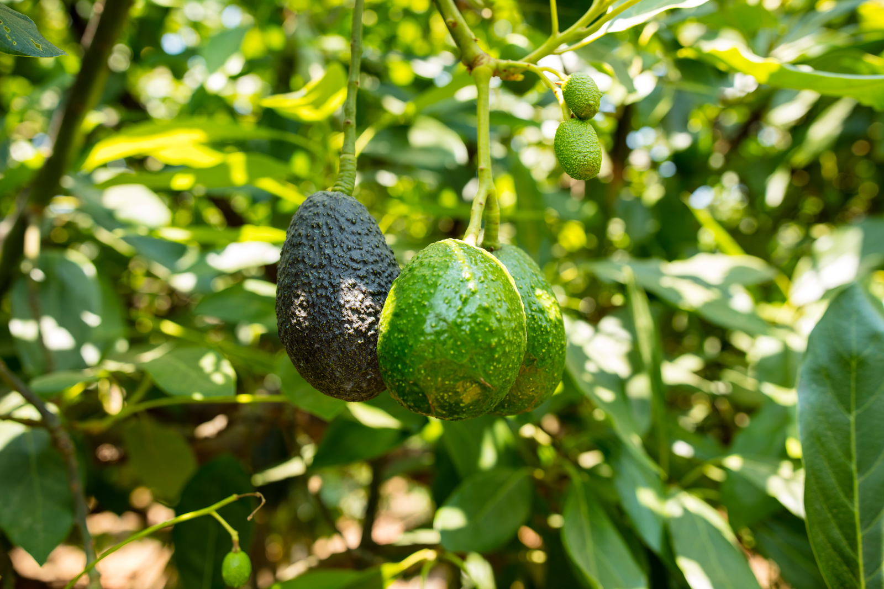
Avocado Dataset Machine Learning Analysis

Slide 2
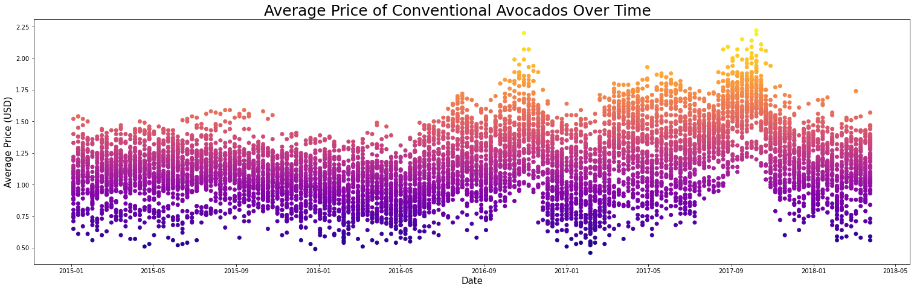
Average price of conventional avocados over time

Slide 3
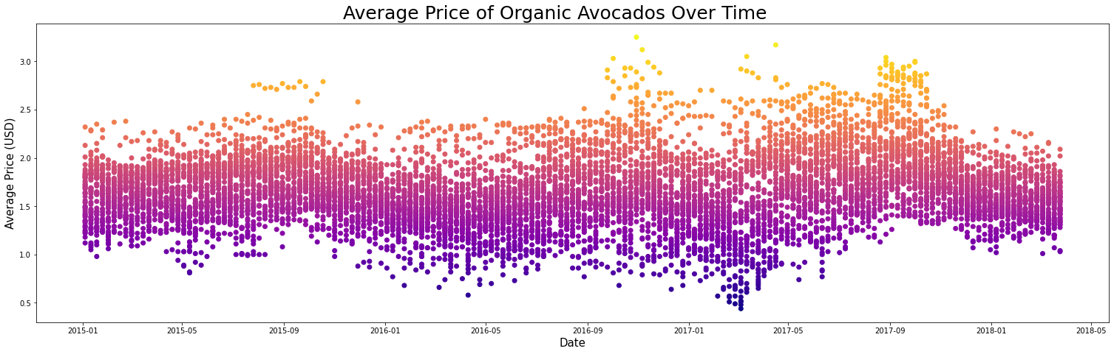
Average price of Organic avocados over time

Slide 4
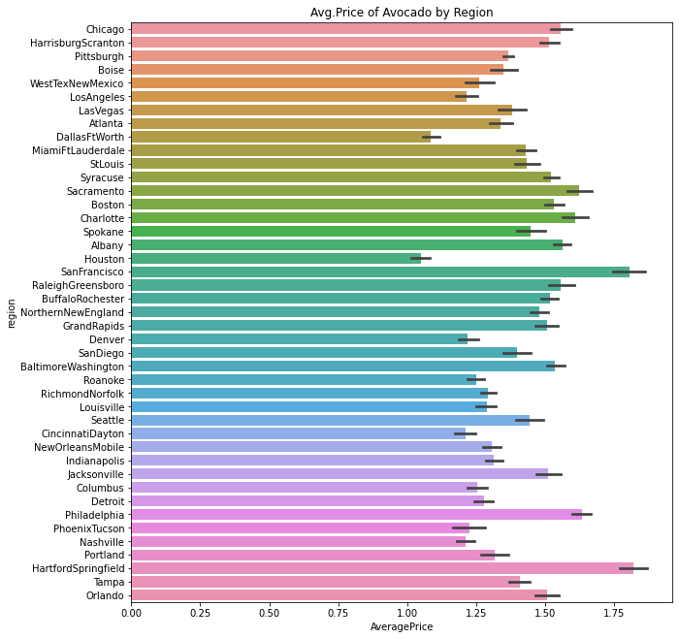
Average price of avocado by Region
Sanfransico has the highest avg price

Slide 5
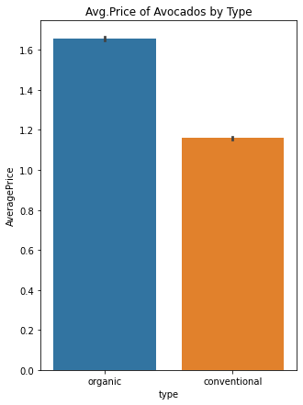
Average price of avocado by Type
Organic type is costly compared to conventional type

Slide 6
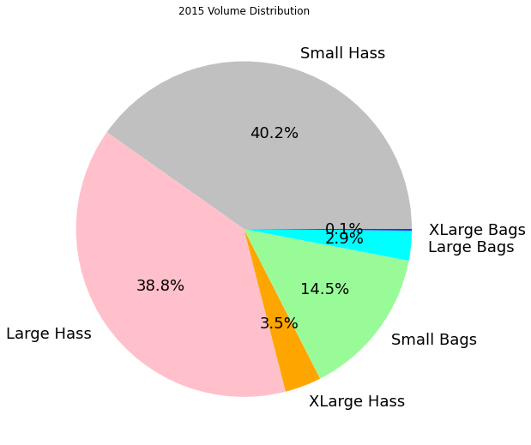
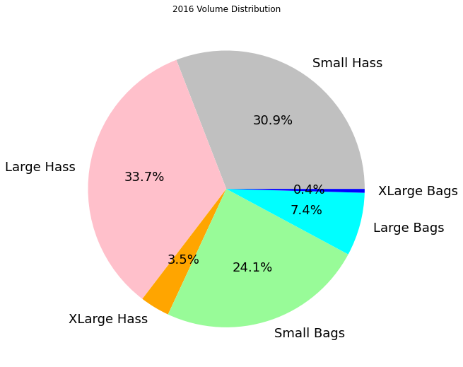
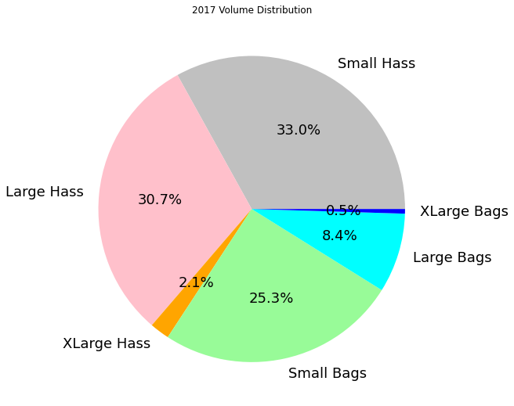
Distribution of avocados by year

Slide 7
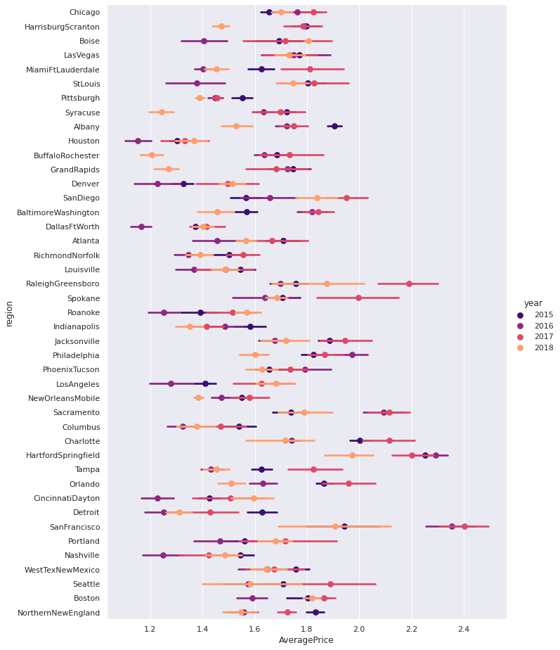
Average price of avocado for organic type by region
In Organic type , which region has the highest avg price

Slide 8
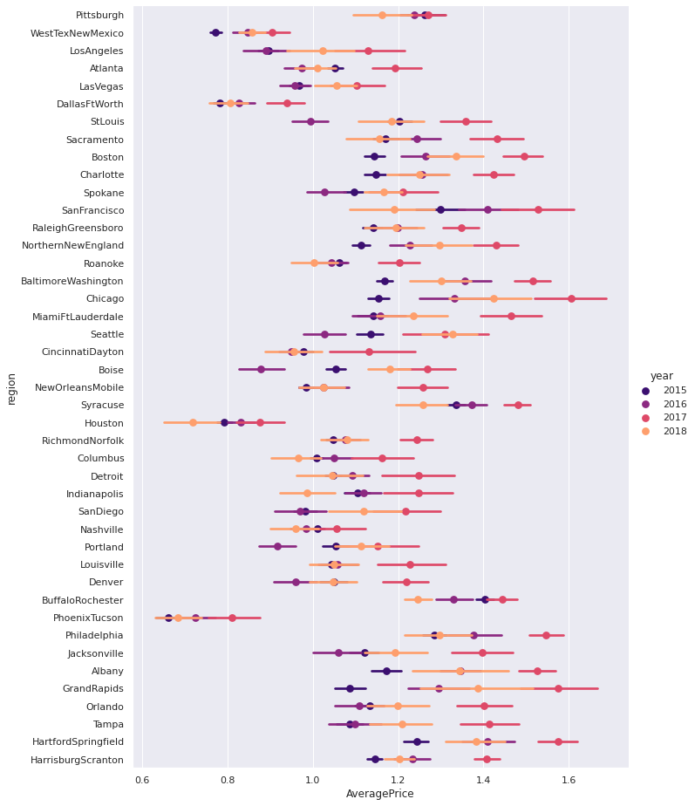
Average price of avocado for Conventional type by region
The prices are lower compared to Organic type

Slide 9
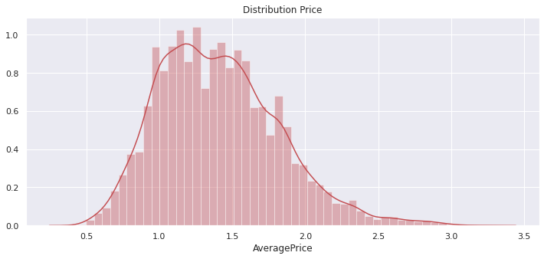
Average price distribution

Slide 10
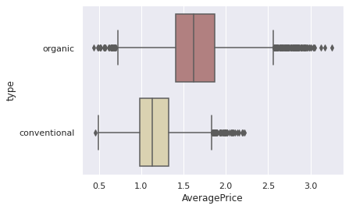
Box plot to show which avocado type is expensive
Organic type are more expensive than conventional types

Slide 11
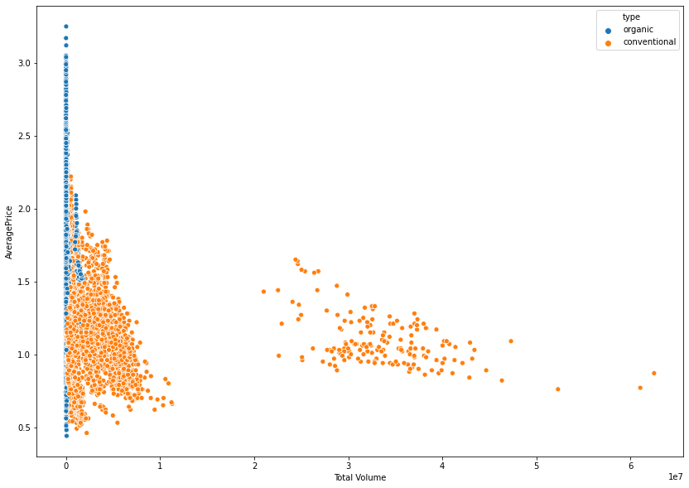
Average prices vs Total Volume

Slide 12
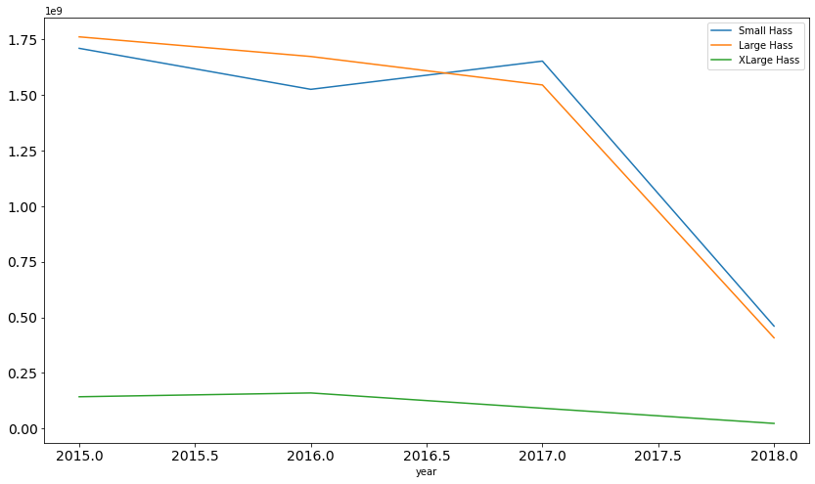
Avocado types vs Year

Slide 13
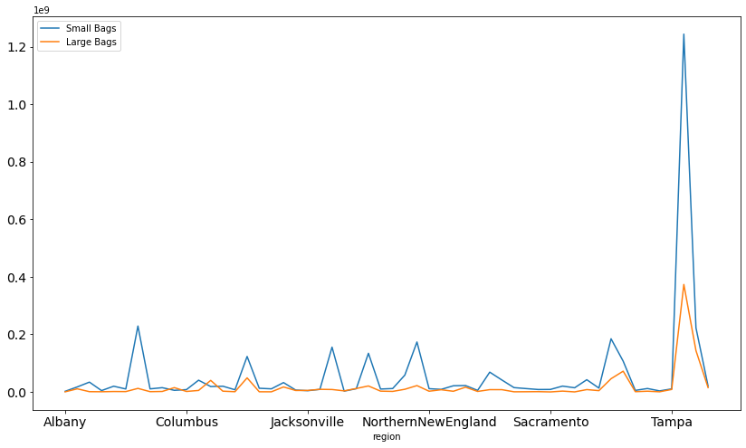
Small bags, Large bags vs Region

Slide 14
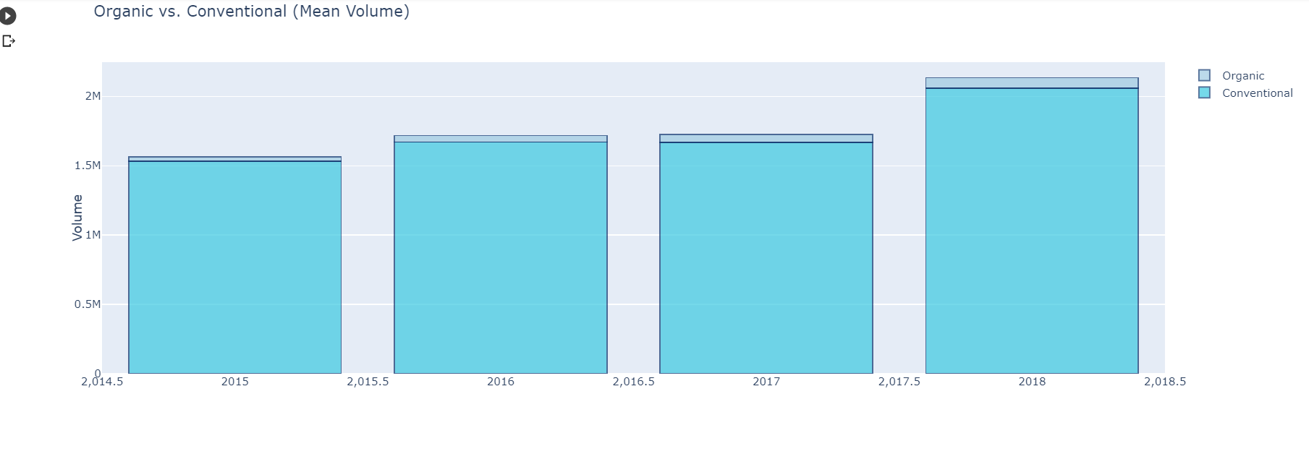
Conventional vs Organic(Mean volume)

Slide 15
Linear Regression:
RMSE test :0.1122
MAE:0.085
MSE:0.012

Slide 16
Decision Tree Regression:
DTree score:0.723
RMSE test :0.0969
MAE:0.073
MSE:0.0093

Slide 17
Random Forest Regressor:
RForest score:0.977
RMSE:0.064
MAE:0.047
MSE:0.0042

Slide 18
Model Evaluation: Comparing the RMSE value of the models
RMSE value of the Linear Regr : 0.1123
RMSE value of the Decis Tree : 0.097
RMSE value of the Rnd Forest : 0.065

